Slide 1
National Gallery
of Art

Slide 2
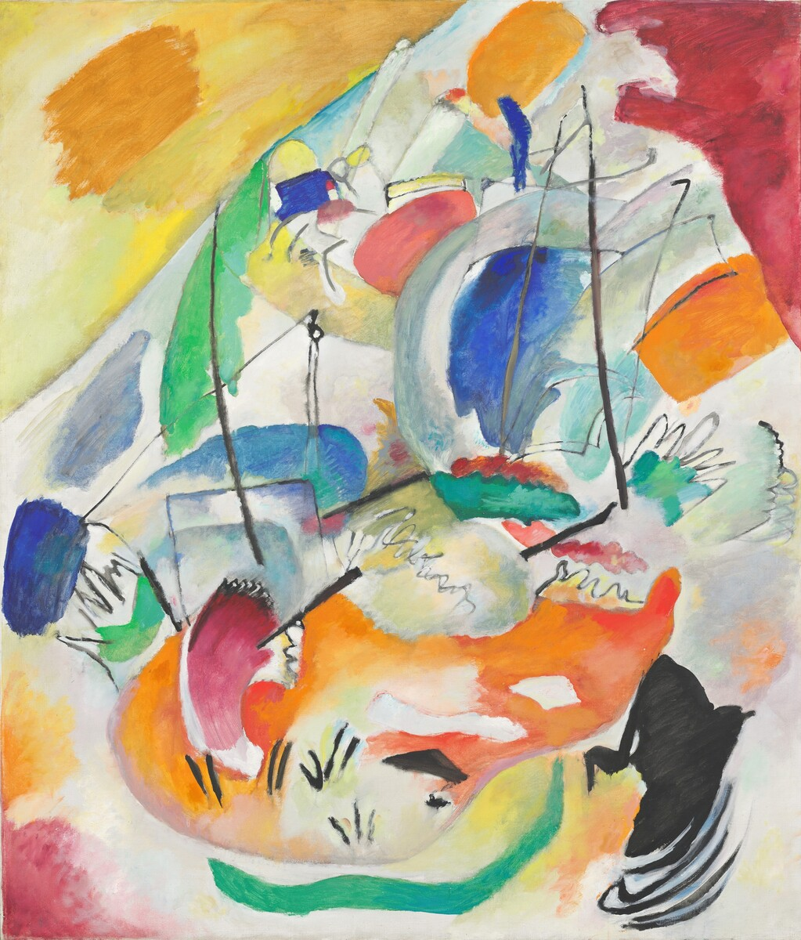
Notes:
​​Wassily Kandinsky, Improvisation 31 (Sea Battle), 1913, oil on canvas
overall: 140.7 x 119.7 cm (55 3/8 x 47 1/8 in.)
National Gallery of Art Washington, Ailsa Mellon Bruce Fund, 1978.48.1
You are looking at a high-resolution digital reproduction of an abstract painting made by the Russian artist, Wassily Kandinsky in 1913 titled ​Improvisation 31​, also known as ​Sea Battle​. Who was Wassily Kandinsky? Kandinsky helped invent this new way of painting called Abstraction that inspired much of the art made in Europe and America in the early 20th century. Before Kandinsky's time, artists mostly painted in a realistic manner, meaning viewers could easily recognize people, places, and objects and view them in the painting as they would appear in the real world. Kandinsky was born in Moscow, Russia in 1866. As a child, he loved music and learned to play the piano and cello. He also took drawing lessons, later commenting, "I remember that drawing, and a little later painting, lifted me out of reality." Kandinsky became a lawyer but gave up law at age 30 to move to Munich, Germany and study modern painting. He soon became a leader in a modern art movement that embraced abstraction. This painting, ​Improvisation 31​, ​Sea Battle​, is one of Kandinsky's early abstract masterpieces, expressing his innermost thoughts and feelings. What you see here, according to Kandinsky, is the essence of human emotion and ideas such as conflict or chaos that are transmitted through the colors, shapes, lines, and forms. It is possible that Kandinsky actually experienced each color as a specific sound and emotion. He created a detailed system that assigned each color to an emotion, feeling, or idea. For example, he wrote, "Blue is the typically heavenly color. In musical terms, light blue resembles the flute. Dark blue, the cello. Yellow is the typical earthly color. Yellow affects us like the shrill sound of a trumpet being played louder and louder. "Through his choice and arrangement of specific shapes, lines, and colors, Kandinsky wanted the viewer to experience a sequence of emotions, just as you would when listening to a musical score.
What’s going on in​Improvisation 31 (Sea Battle)​? Are you wondering what exactly is going on in this painting? Between 1909 and 1913, Kandinsky made a series of abstract paintings entitled, "​Improvisation​." An improvisation is a musical term that means an unplanned or unpracticed performance that involves imagination and creativity. Though, Kandinsky made sketches, he wanted it to feel spontaneous. Kandinsky gave Improvisation #31​ an additional title, "​Sea Battle​", which might help us understand the painting. Do you see two battling ships in the center marked by their vertical masts and billowing sails? Now look for cannons that fire at each other creating the smoky cloud in between. Then turn your eyes to the scribbled loops. They suggest the splashing sea. And towards the top, a group of smaller shapes might represent a distant city being demolished by huge waves. Though the painting was made in the years before WWI, Kandinsky claimed he was not referring to “war talk,” but instead using these motifs to suggest what he called "a terrible struggle going on in the spiritual atmosphere. "He believed that art had great spiritual potential, that it could help people cut ties to material concerns and bring a new spirituality to the world, making it a better place.

Slide 3
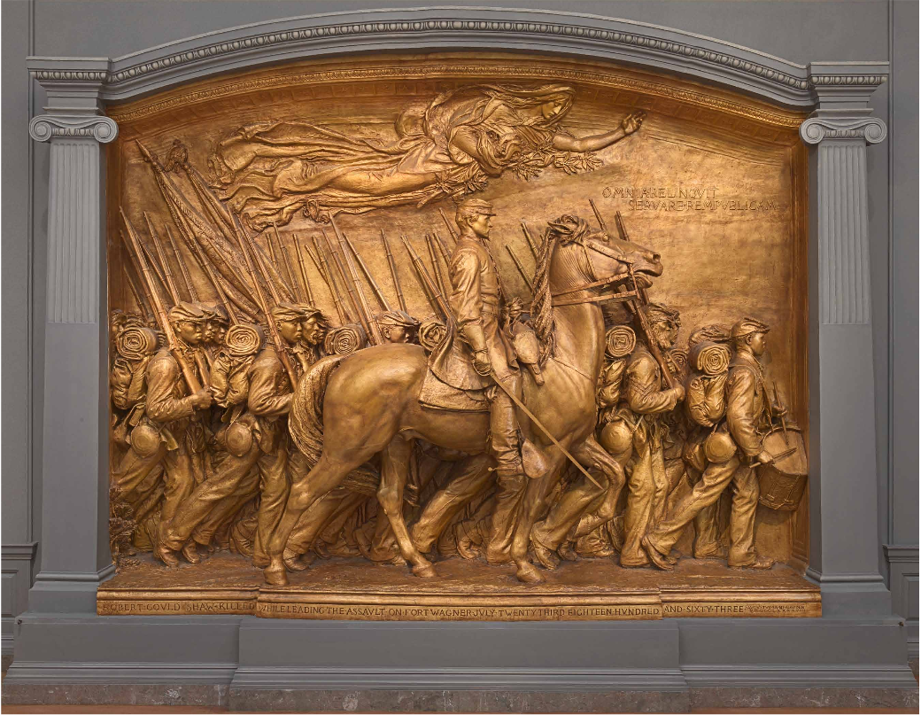
Notes:
Augustus Saint-Gaudens, Shaw Memorial, 1900, patinated plaster
overall (without armature or pedestal): 368.9 x 524.5 x 86.4 cm (145 1/4 x 206 1/2 x 34 in.) overall (with armature & pedestal): 419.1 x 524.5 x 109.2 cm (165 x 206 1/2 x 43 in.)
U.S. Department of the Interior, National Park Service, Saint-Gaudens National Historic Site, Cornish, New Hampshire, X.15233
You are looking at a high-resolution digital reproduction of a memorial sculpture made by American artist Augustus Saint-Gaudens in 1900 titled The​ Shaw Memorial​. Did you know that by the end of the American Civil War, African Americans made up almost 10% of the Union Army? That’s almost 180,000 soldiers who fought on behalf of the North! The ​Shaw Memorial​ by Augustus Saint-Gaudens calls to our memory the brave actions of the 54th​ Massachusetts Volunteer Regiment, the first African American troop from the North to fight on behalf of the Union in the American Civil War. Colonel Robert Gould Shaw, a young white officer from a strongly abolitionist family in Boston, led the 54th ​Regiment, which is why he is in the center on horseback. Would you like to know more of the history behind the events in this sculpture? When President Abraham Lincoln signed the Emancipation Proclamation in 1863, declaring enslaved people in the South to be free and allowing African Americans to join the Union Army, the 54th​ Regiment was formed. It was made up of 1,000 men of all ages, including the two sons of Frederick Douglass, the grandson of Sojourner Truth, and Sergeant William Carney, who would become the first African American to be awarded the Congressional Medal of Honor. Look for a soldier who could be a sergeant. The man marching directly in front of the horse with chevrons on his sleeve might represent him. Colonel Shaw and the enlisted men trained together through the spring of 1863. In the summer, the 54th Regiment marched through Boston Common and boarded a ship to South Carolina to join the war in an effort to end slavery. They fought their first battle on James Island and won. Then they marched further to Fort Wagner, a Confederate stronghold. Do you see the drummer boy in the front? Some researchers believe his name was Alex Johnson. Only 16 years old, the drummer set the marching tempo for the troop and sent signals to officers. In the fierce battle on July 18, 1863, Colonel Shaw died on the battlefield, and almost half of his men were killed, captured, or injured. Sergeant William Carney saved the American flag from touching the ground, when the flag bearer and Colonel Shaw were shot. The soldiers’ extraordinary courage spread and inspired many more African Americans to enlist in the army. President Lincoln said that if it weren’t for the valor and service of the 54th Regiment, setting an example that inspired many thousands of African Americans to enlist, the North may have lost the war.
Are you wondering how the Shaw Memorial came to be? Shortly after the Battle of Fort Wagner, the surviving soldiers of the 54th expressed their desire to create a memorial to their fallen commander. A committee later commissioned renowned American sculptor Augustus Saint-Gaudens to create a monument. Saint-Gaudens first draft of the sculpture showed only Shaw on horseback. When Colonel Shaw’s abolitionist parents saw the model, they insisted that the men of the 54th​ Regiment be memorialized along with him. Look carefully at each individual face. Saint-Gaudens made small portrait busts, sculpted in clay from live models, to represent each soldier, and studied photographs of Shaw. He called the Shaw Memorial “a labor of love” and created two versions – a bronze version, which stands permanently outdoors in Boston Common, and a painted plaster version, seen here. Do you notice what looks like an angel at the top of the sculpture? She is meant to be an allegorical or symbolic figure. She holds an olive branch, a symbol of peace, and poppies—symbols of death, sleep, and remembrance. The Latin words below her state: “He left behind everything to preserve the Republic.”

Slide 4
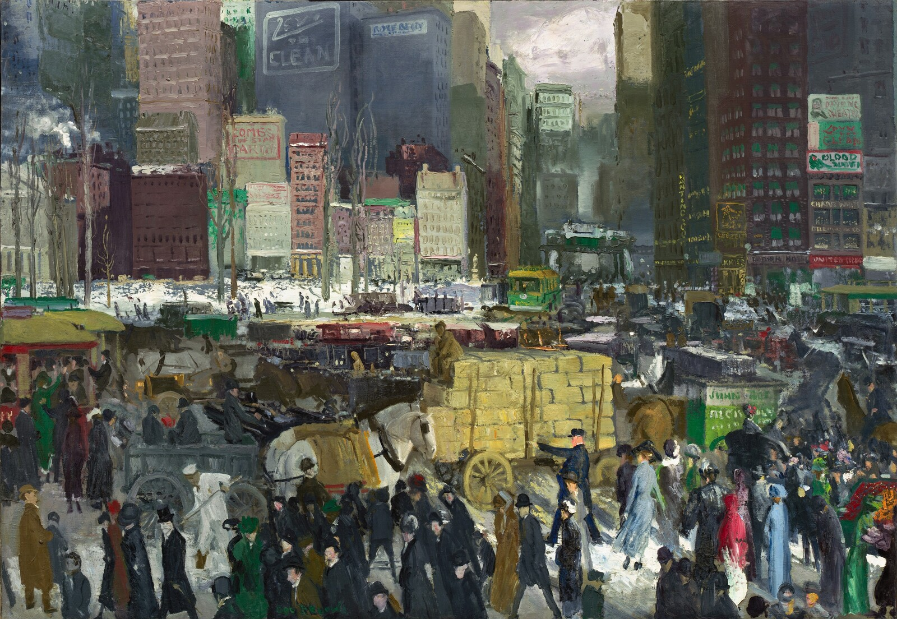
Notes:
George Bellows, New York, 1911, oil on canvas
overall: 106.7 x 152.4 cm (42 x 60 in.) National Gallery of Art Washington, Collection of Mr. and Mrs. Paul Mellon 1986.72.1
You are looking at a high resolution digital reproduction of a painting made by the American artist George Bellows in 1911, titled ​New York. How did George Bellows become an artist? Given the choice of becoming an artist or a professional baseball player, which would you choose? Growing up in Ohio in the 1890s, George Bellows loved both sports and art. In college, he drew illustrations for the school yearbook, sang in the glee club, and played basketball and baseball. In his early twenties, he was offered the chance to play professional baseball, but turned it down to become an artist. In 1904, Bellows moved to New York to pursue his career in art. He enrolled in the New York School of Art, studying under the well-known teacher and artist Robert Henri. Henri encouraged students to be inspired by real life. He wrote: “Draw your material from the life around you, from all of it. There is beauty in everything if it looks beautiful to your eyes.” Bellows, together with a group of New York artists, followed Henri’s advice, and focused on painting the gritty side of city life. Bellows’ early paintings depicted New York’s busy streets, boxing matches, construction sites, commercial docks, and poor neighborhoods. Many artists in the early twentieth century worked as reporters and illustrators. Before the widespread use of photography in newspapers and magazines, their drawings served to document current events. As a painter of modern life Bellows focused on contemporary social, economic, and political issues, including poverty and the impact of large construction projects on neighborhoods. He said, “Every artist is looking for news. He is a great reporter of life, keeping his eyes open for some ...untold piece of reality to put on his canvas. His picture chooses him.”
How did Bellows choose to show the city of New York? When George Bellows painted ​New York​ in 1911, the city was quickly becoming the nation’s preeminent modern city. Imagine yourself standing in the middle of this scene. What might you hear, smell, or feel? Bellows captured the whirlwind of activity on a winter day. The picture is a congestion of buildings, signage, and people and goods on the move. Motorcars mingle with horse-drawn carts and trolleys while pedestrians hurry along packed sidewalks. When Bellows created this work of art, the traffic light had not yet been invented. In the painting you can see a policeman trying to direct traffic, a street cleaner busy sweeping, and a woman stopping at a vegetable cart. Bellows use of loose, expressive brushstrokes conveys the energy of the scene. Although the painting’s general location is Madison Square, at the intersection of Broadway and23rd Street, Bellows imaginatively combined elements that could not be seen from a single viewpoint. Many of Manhattan’s most famous features are here: skyscrapers, apartment buildings, elevated train tracks, a subway entrance, electric signs, advertising billboards, a tree-lined park, and dense crowds. While these features are familiar today, they represented an awe-inspiring, modern experience for most people at the beginning of the twentieth century. During Bellows’ life, New York was becoming a metropolis with vast building projects that included new bridges, railroad stations, and skyscrapers. The energy, drama, and scope of these engineering feats fascinated Bellows, and he made many paintings–such as this one–documenting the rapidly changing urban landscape. Bellows noted, “I paint New York because I live in it and because the most essential thing for me to paint is the life about me, the things I feel today and that are part of the life of today.”

Slide 5
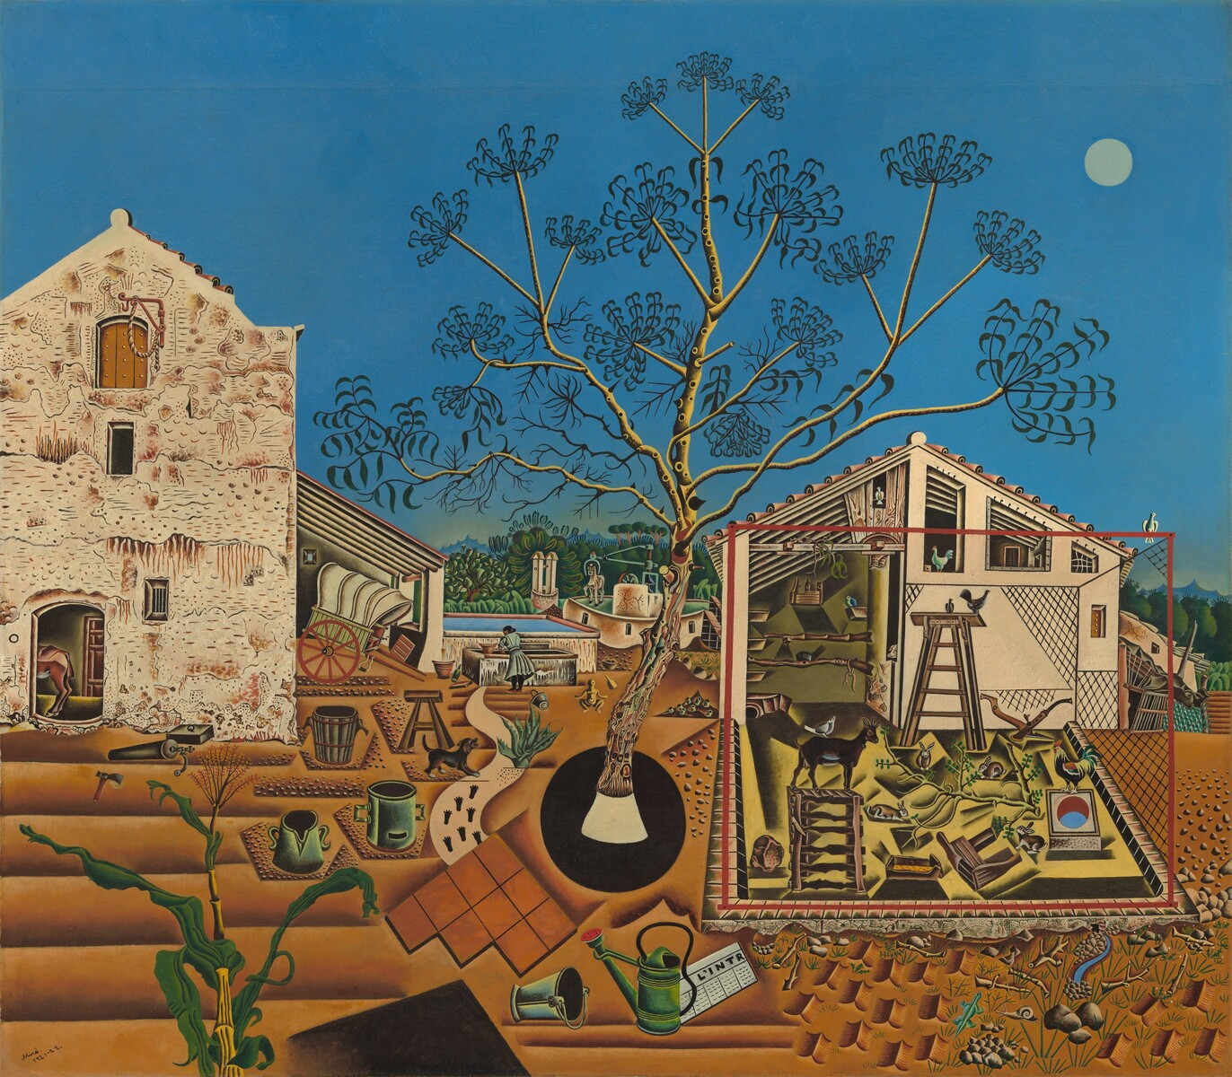
Notes:
Joan Miró, The Farm, 1921-1922, oil on canvas
overall: 123.8 x 141.3 x 3.3 cm (48 3/4 x 55 5/8 x 1 5/16 in.)
National Gallery of Art Washington, Gift of Mary Hemingway 1987.18.1
You are looking at a high-resolution digital reproduction of a painting by the Spanish artist Joan Miró entitled ​The Farm​, made in 1921. What might be happening in this painting? There’s a lot going on in this picture! A large carob tree, filled with curling pods, in the center of the canvas. Footsteps along a path. A barking dog. A woman washing clothes at a trough while a donkey plods around a millstone. There is an open structure occupied by rabbits, a goat, a pigeon, a chicken, a rooster, and a pig! And a farmhouse, its exterior covered in moss and cracks. A horse rests inside and a covered wagon is propped outside. The foreground is a dry, arid landscape of warm oranges and browns. Buckets, pails, and watering cans litter the yard. A newspaper lies in the dirt. A lizard and snail crawl amid grass, stones, and sticks. Off in the distance, there is a lush, green forest and mountains. Is that a sun or moon in the sky? A baby or a Buddha? Miró leaves us guessing. This painting is a “portrait” of a cherished place – Joan Miró’s family farm in Catalonia. Describing it, he said, “Everything I painted was really there, but I took liberties—I left off the wall of the chicken coop so that one could look inside—and there are lapses in scale. ​The Farm​ carried minute realism as far as I could take it.... “Miró said ​The Farm​ “attempts to summarize the world around me.... ​The Farm​ was a resume of my entire life in the country. I wanted to put everything I loved about the country into that canvas—from a huge tree to a tiny snail.”
How did Miró come to make this painting? Joan Miró was born, educated, and trained as an artist in Barcelona, Spain. During his youth he spent summers at his family’s farm in Montroig, a nearby village. These summers became an important touchstone for Miró’s artistic identity. ​In 1920 at the age of twenty-seven, he moved to Paris. There he was inspired by Cubist art, with its fragmented objects and abstract forms. He was also influenced by the Surrealist poets and painters, who aimed to release the creative power of the subconscious mind by making images in which the familiar met the fantastical. While living and learning in Paris, Miró remained deeply attached to his native home in Catalonia. He returned to the family farm and began creating this painting​ ​in the summer of1921. He continued working on it in Barcelona and then, when he moved back to Paris, he had herbs sent from the farm to remind him of the shapes of the leaves growing there. It took him a full nine months to finish this painting. This early painting is an example of how Miró made the ordinary extraordinary. The scene is both real and unreal -- familiar, yet unfamiliar. Each element in the farmyard is carefully observed and precisely described, yet the overall effect is strangely dreamlike. Miró’s style creates a kind of magical realism. The artist came to regard ​The Farm ​as one of his key works. Describing it, he said, “This picture represents all that was closest to me at home, even the footprints on the path by the house.... I am very much attached to the landscape of my country. That picture made it live for me.”

Slide 6
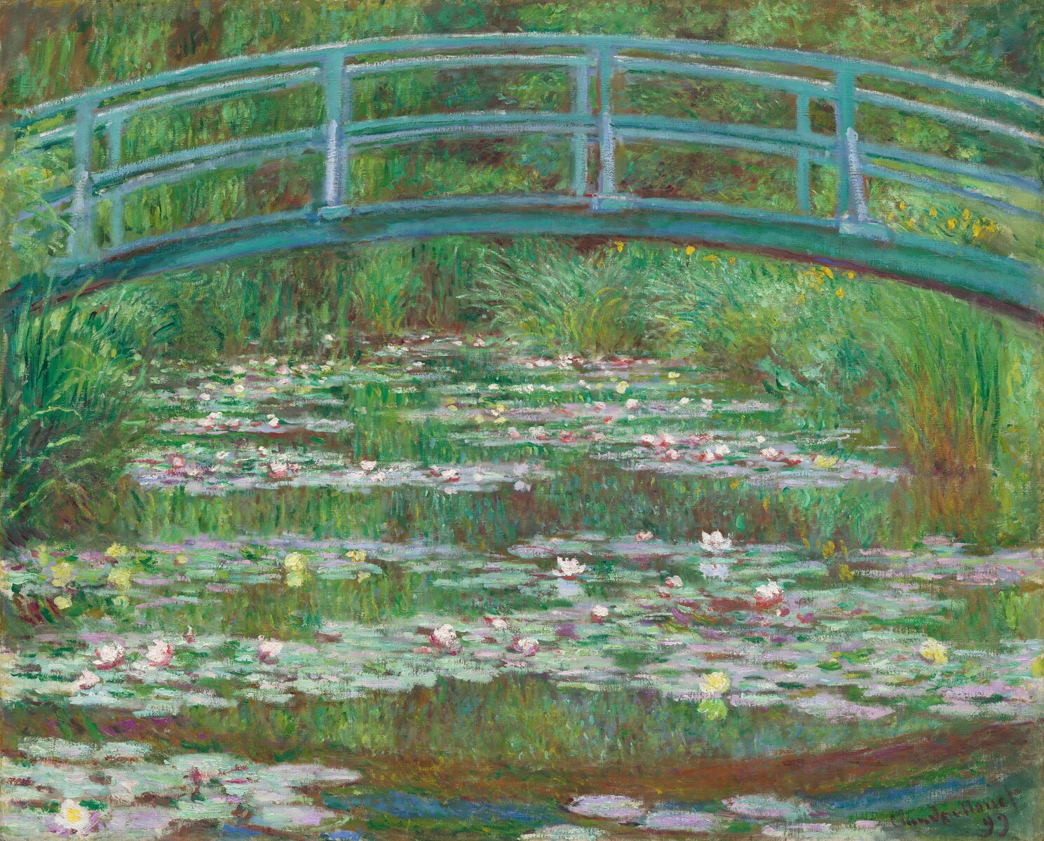
Notes:
Claude Monet, The Japanese Footbridge, 1899, oil on canvas
overall: 81.3 x 101.6 cm (32 x 40 in.)
National Gallery of Art Washington, Gift of Victoria Nebeker Coberly, in memory of her son John W. Mudd, and Walter H. and Leonore Annenberg, 1992.9.1
You are looking at a high-resolution digital reproduction of a painting made by the French artist Claude Monet in 1899, titled ​The Japanese Footbridge​. How did Monet make his paintings? Bienvenue​! Welcome to the garden of Claude Monet. Monet was one of the leaders of the Impressionists, a group of innovative artists working mostly in France in the mid-to-late 1800s.The Impressionists wanted to capture the momentary effects of light and color on the landscape—the way the landscape looks different depending on the season, the weather, and the time of day. They worked quickly, often ​en plein air—​outside, in the open air. This sometimes presented problems: artists had to cope with all kinds of conditions. And when the light changed, they might have to set one painting aside and work on another. Monet often worked in series, making several paintings of the same subject. Monet’s work, with its bright colors and bold brushstrokes, looked very different from the more polished style of painting accepted by the art academies of Paris at the time. But as Impressionism became more popular, Monet gained recognition. In 1883, Monet and his family were able to move to a large pink farmhouse in the village of Giverny, about fifty miles from Paris. He lived and painted there for the rest of his life.
What inspired Monet to make ​The Japanese Footbridge​? Monet’s gardens at Giverny, which he designed himself, became the main source of inspiration for his work. He carefully planned his gardens to be beautiful and different as the seasons changed. Something was always in bloom! When the grounds at Giverny became too much for Monet to manage on his own, he hired a team of six full-time gardeners to help him plant and maintain them. Then Monet embarked on another ambitious project: a water garden, inspired in part by the country of Japan. He bought a piece of land across the road from his house and arranged to divert a small stream there, in order to construct a pond. To evoke the feeling of a Japanese garden, Monet lined the curving banks of the pond with iris and bamboo. Japanese maples and weeping willows surrounded the pond, and water lilies—creamy yellow, pink, and white—floated on its surface. Finally, Monet built an arched wooden footbridge based on the bridges in the Japanese prints he collected. But Monet’s bridge was painted a brilliant blue-green instead of the red traditionally used in Japan. The Japanese Footbridge​ is one of a series of twelve paintings that Monet made in 1899 of the bridge and waterlily pond. Here, the pond itself nearly fills the canvas: Monet has cropped out both sky and shore. The lilies form horizontal bands on the shimmering surface of the water, while the reflections of the reeds and willow branches are rendered with short, vertical brushstrokes. The bridge itself curves across the top of the canvas in an unbroken line—look for its reflection in the water below.

Slide 7
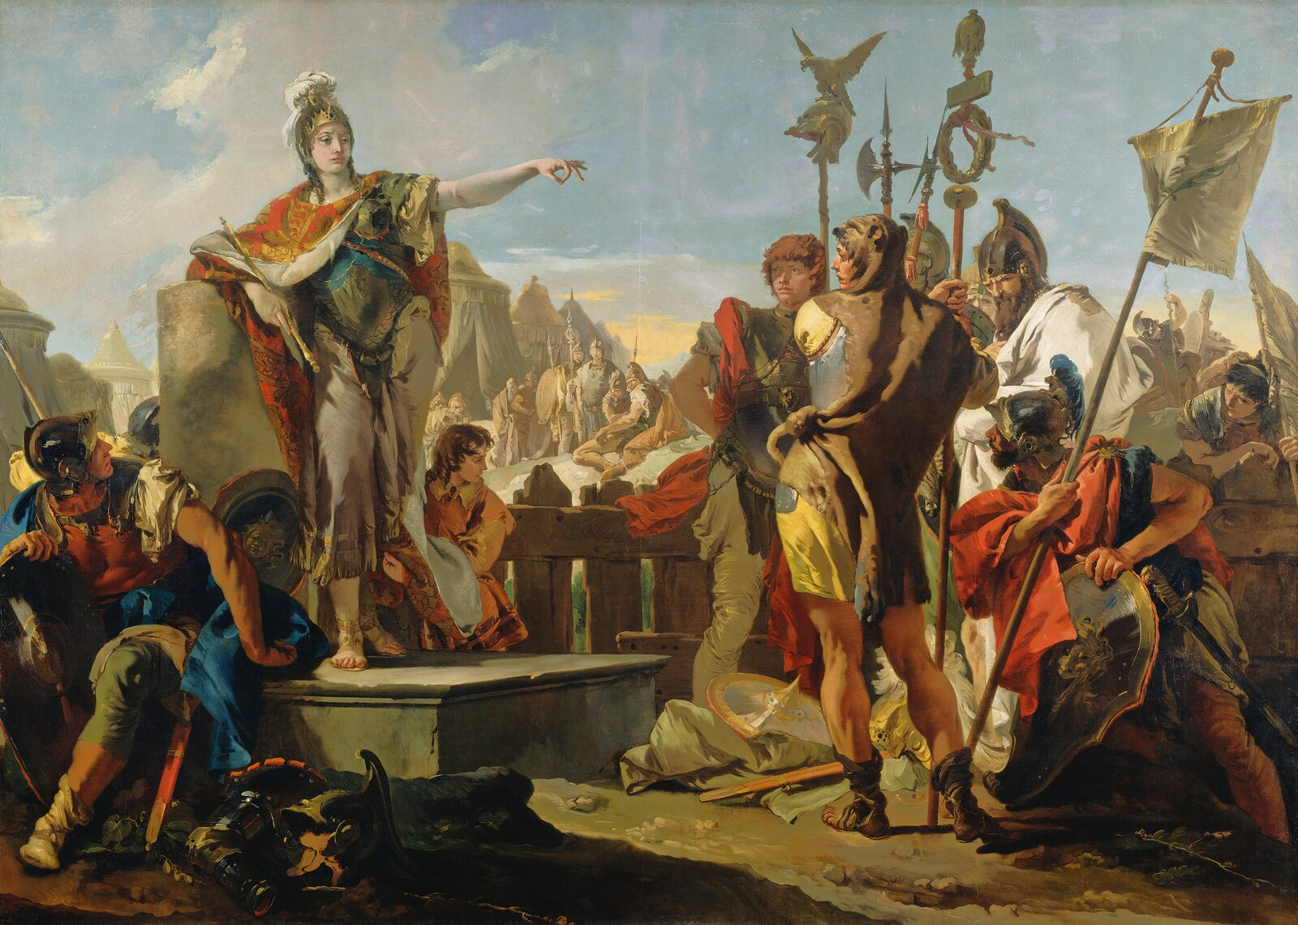
Notes:
​​Giovanni Battista Tiepolo, Queen Zenobia Addressing Her Soldiers, 1725/1730, oil on canvas
overall: 261.4 x 365.8 cm (102 15/16 x 144 in.)
National Gallery of Art Washington, Samuel H. Kress Collection, 1961.9.42
You are looking at a high-resolution digital reproduction of a painting made by the Venetian artist Giovanni Battista Tiepolo, made probably between 1725 and 1730, titled ​Queen Zenobia Addressing Her Soldiers​. Do you know the story of Queen Zenobia? You may have heard of Cleopatra, but in some parts of the world, Zenobia is even more famous! Zenobia was queen of Palmyra, in Syria, in the third century CE. Palmyra had long been an oasis for caravans traveling between the Persian Gulf and the Mediterranean Sea. By this time, it had become an important economic and military power in the Near East. After her husband Odenathus (aw-den-á-thus) was assassinated in 267 CE, Zenobia took power over Palmyra. She ruled as regent for her infant son. A skilled diplomat and military strategist, she challenged the authority of the Roman Empire in the East. She took an unusual role for a woman in the ancient world and led her troops to victories in Egypt and Asia Minor, winning their admiration and respect. In just five years, Queen Zenobia became a threat to Rome. Then, the Roman Emperor Aurelian brought the Roman army to lay siege to Palmyra. In Tiepolo’s painting, Zenobia is addressing her soldiers just before the final battle. A warrior queen, she’s wearing armor, and her shield rests at her feet. A servant keeps her robes from touching the ground. Zenobia’s soldiers, carrying standards and the flag of Palmyra with its crossed palms, look up at her as she speaks to them from a raised platform or dais. Her pose recalls how Roman emperors were depicted in ancient sculpture and coins. Her gesture—an outstretched arm, making a circle with her thumb and index finger—might have been intended to call everyone to order. Sadly, Zenobia was defeated by the Emperor Aurelian, and this was the beginning of the end for Palmyra. Zenobia herself was taken prisoner and brought to Rome, where she was paraded through the streets in golden chains.
You might be wondering... Why did Tiepolo make this painting? Giovanni Battista Tiepolo worked in Venice, Italy, in the eighteenth century, in the grand tradition of history painting. The word history comes from the Italian ​istoria​, meaning narrative or story, and Tiepolo’s subjects were drawn from history, literature, mythology, and religion. Tiepolo worked on a correspondingly large scale—this painting is eight-and-a-half feet tall and twelve feet wide! Although Queen Zenobia remained a model of valor throughout history, representations of her were rare in Venetian art – art made in Venice, Italy, between the 15th​ and 18th centuries. A prominent family in Venice, the Zenobio family, probably commissioned Venetian artist Tiepoloto make at least three paintings to depict Queen Zenobia’s story. With nearly identical surnames, the Zenobio family may have wanted to claim that Queen Zenobia was a distant ancestor. Notice the clear light and saturated color, characteristic of Venetian painting, and the theatrical composition, with the figures in the foreground arranged as if on a stage. The other two narrative paintings in this series are now in other collections. They depict Zenobia in chains, and Zenobia before the Emperor Aurelian, and share these traits of Venetian painting. Throughout his long career, Tiepolo’s fame continued to grow, and today it rests in his ability as a dramatic storyteller of both the sacred and the secular. In addition to decorating the churches and palazzi of Venice, he took commissions from abroad for other large paintings and ceiling frescoes. Today, the monumental ruins of the city of Palmyra, in the Syrian desert northeast of Damascus, are a UNESCO World Heritage site. Tragically, much of these ancient sites were destroyed by terrorists in recent years, yet the story of Queen Zenobia lives on today.

Slide 8
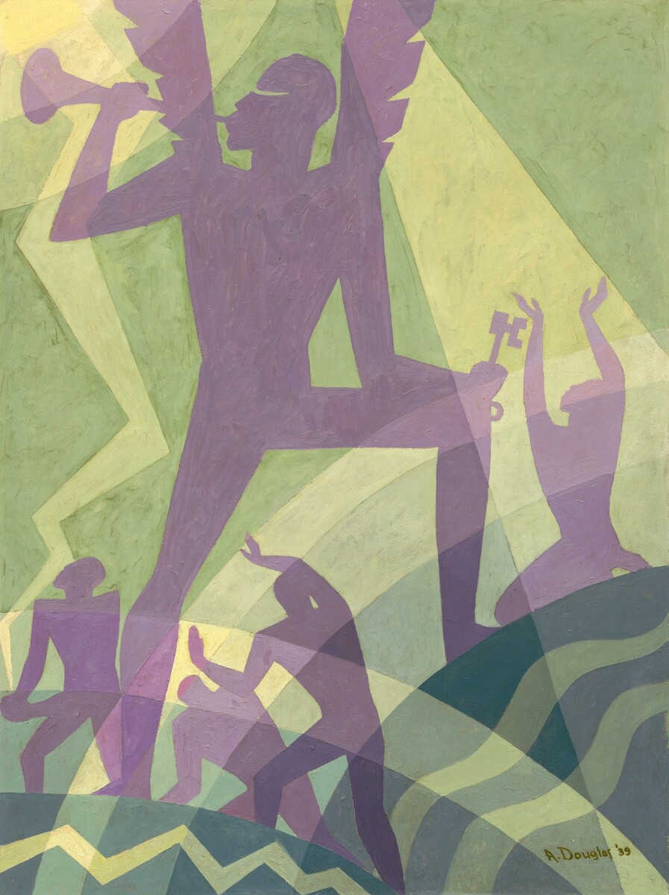
Notes:
Aaron Douglas, The Judgment Day, 1939, oil on tempered hardboard
overall: 121.92 × 91.44 cm (48 × 36 in.)
National Gallery of Art Washington, Patrons’ Permanent Fund, The Avalon Fund, 2014.135.1
You are looking at a high-resolution digital reproduction of a painting made by the American artist Aaron Douglas in 1939, titled ​The Judgment Day. What influenced Aaron Douglas’ art? Born in Kansas in 1899, Aaron Douglas started drawing and painting as a young boy. He would go on to become the first African American to earn a degree in art from the University of Nebraska. He taught high school art, and then, in 1925, made the bold decision to move to Harlem, the cultural capital of black America in the early 20th century. There he joined a movement that would become known as the Harlem Renaissance—an explosion of cultural activity by black scholars, writers, artists, poets, and musicians—that included W.E.B. DuBois, Langston Hughes, Zora Neale Hurston, Augusta Savage, Duke Ellington, and many others. These artists were eager to experiment with new ways of expressing themes of racial pride, African roots, the American South, and social and political equality—and Douglas was excited to join them. Douglas developed a unique style, emphasizing strong lines, flat colors, and silhouetted forms. He combined these features with motifs from traditional African art, the rhythms of jazz music, and elements of New York’s Art Deco architecture and design. Douglas said: “My work impacted the art world by just being different. When I first went into the arts, I had the intentions of doing classical art, something that everyone knew well. But [my teacher] helped me find my own artistic style. Something that was personal and that nobody had seen before. Something like modern and African mixed together to create a new experience out of the old. ”Douglas believed in the power of education as a force for change in African American life. In1938, he began teaching at Fisk University in Nashville, where he founded the art department. He continued teaching at Fisk faculty for nearly 30 years, training several new generations of African American artists.
What’s going on in this picture? The Judgment Day ​depicts the archangel Gabriel, in streaming light, standing astride earth and sea—a trumpet in one hand and key to heaven in the other. The painting refers to life after death and how, on the Day of Judgment, the souls of the living and the dead will be redeemed or condemned, depending on their faith and actions during earthly life. Holding a key to the kingdom of heaven in his left hand, Gabriel blows his trumpet to summon the souls of the earth to judgment. The souls of the dead are waking; two of them raise their hands in praise and recognition of the music. The rhythm is conveyed by concentric circles and waves—as if the sound of the trumpet is echoing throughout the work through the yellow, green, and lavender tones. It was in 1927 that James Weldon Johnson, a writer and activist, asked Douglas to create the illustrations for his book, ​God’s Trombones: Seven Negro Sermons in Verse​. Each of Johnson’s sermons, or poems, was based on a story from the Bible—and each one resounded with the rhythms and cadence of traditional African American sermons. Douglas studied the verses and strove to express these same rhythms in the illustrations he made for the book. Because ​God’s Trombones​ would be printed in black and white, Douglas worked in a distinctive black and white graphic style for the original illustrations. Later, he revisited the drawings, enlarging and translating many into large, colorful oil paintings—like the one you see here of Judgment Day​. Douglas would go on to collaborate with many writers, providing illustrations for their novels and poems. He became one of the most sought-after book illustrators and cover designers of the Harlem Renaissance.

Slide 9
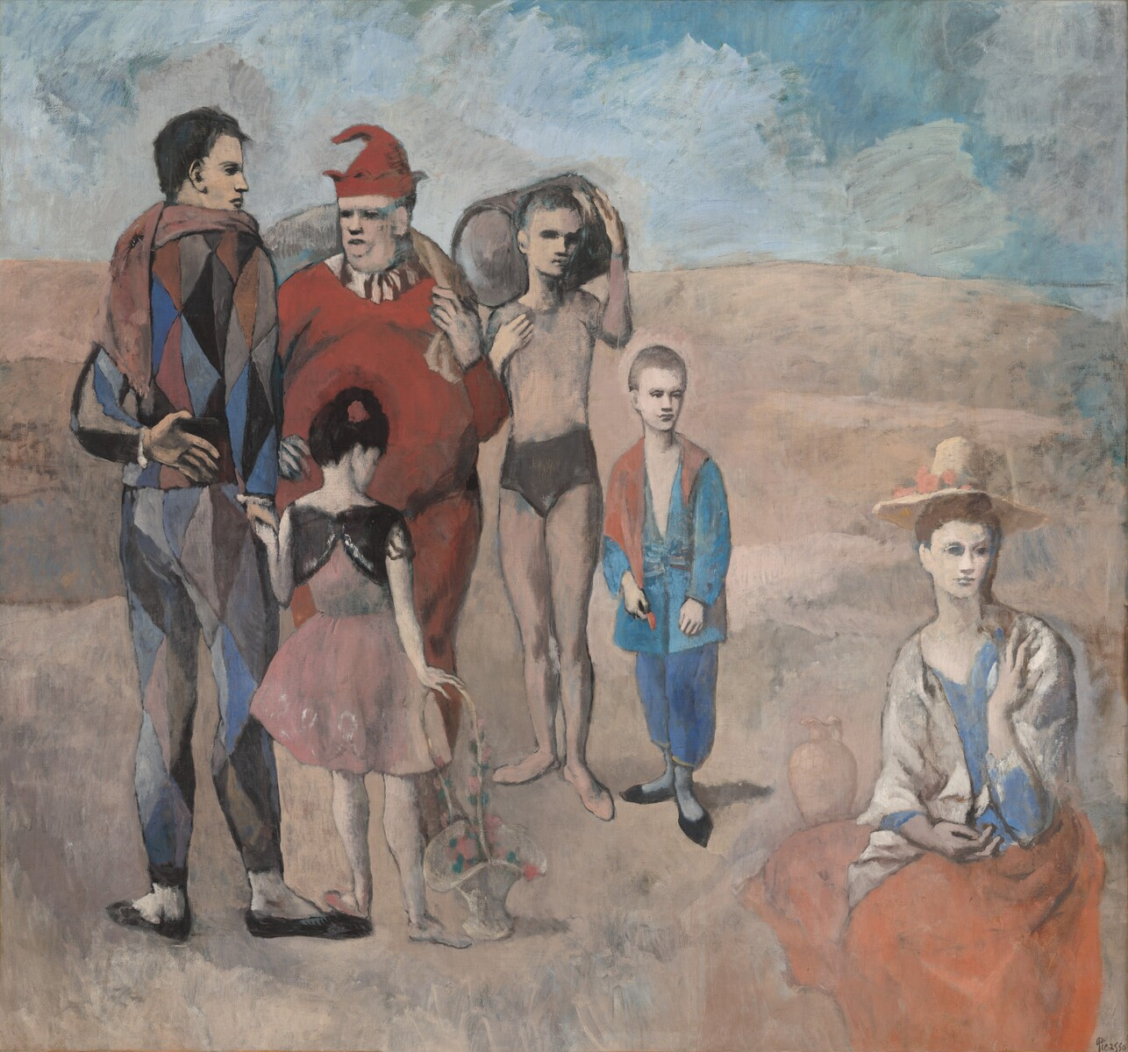
Notes:
Pablo Picasso, Family of Saltimbanques,1905, oil on canvas
overall: 212.8 x 229.6 cm (83 3/4 x 90 3/8 in.)
National Gallery of Art Washington, Chester Dale Collection, 1963.10.190
You are looking at a high-resolution digital reproduction of a painting made in 1905 by the Spanish artist Pablo Picasso, entitled ​The Family of Saltimbanques​. What’s going on in this painting? Picasso introduces us to a family of ​saltimbanques​, or street performers, gathered together in an empty setting. Saltimbanques is a French word that means literally to jump over benches—which is one trick that acrobats do! On the left side of the painting, a harlequin, or jester, wears a diamond-patterned suit. He holds the hand of a young girl in a pink dress who carries a basket of flowers. A large clown in a red costume and two young acrobats—one holding a tumbling barrel—complete the circle. A woman with a hat decorated with flowers sits off to one side. Look again at the painting. Examine each character’s pose, hand and foot gestures, and facial expressions. Some of their gestures echo one another, but their eyes never meet. There is both a sense of connection and of isolation. Shouldn’t these entertainers be juggling, tumbling, dancing, ta-da-ing with broad smiles on their faces—demonstrating the gaiety and energy of a circus? Instead, Picasso presents them in a still, contemplative moment. And where might they be? Are they stranded, in the middle of a desert, or lost on a desolate beach? Picasso gives us few clues. Picasso stated, “Colors, like features, follow the changes of the emotions.” He made this painting early in his career, during a time often described as his Blue and Rose periods. He was exploring the way color and line could express his ideas and emotions. In his Blue Period, Picasso experimented with cool blue tones, creating a series of paintings that evoked sad, melancholy moods. A few years later, Picasso began to paint with warmer, more delicate colors, such as rosy pinks, oranges, reds, and browns. The ​Family of Saltimbanques​ combines his Blue and Rose Period palettes. It is one of the most important paintings of his early career.
How does this painting connect to Picasso’s life? Pablo Picasso was one of the most inventive artists of the 20th​ century. He continually searched for fresh ways to represent the world, and he is admired for his experimentation with different styles, materials, and techniques. He said, “My work is like a diary. To understand it, you have to see how it mirrors my life.” The ​Family of Saltimbanques​ does connect to Picasso’s life at the time. In 1904, at the age of 23, Picasso left his home and family in Spain and moved to Paris, then the center of the art world. He lived in Montmartre, a working-class neighborhood on the outskirts of the city. Montmartre was known for its art galleries, bohemian cafés, night-clubs and dancehalls. There he made friends with other avant-garde artists—writers, poets, and painters who were trying new things and pushing the boundaries of what art could be. He also became fascinated with another group of people he met in the area: the clowns and acrobats who performed in the Cirque Médrano—a circus located nearby. He felt a special connection with these performers and thought of them as outsiders, who like him, were bursting with imagination and creative energy. For Picasso, these wandering saltimbanques were a stand-in for him and his fellow artists, a kind of extended family with whom he identified. In fact, the jester character of Harlequin, a type who wanted to break with society’s traditions, became a personal symbol for Picasso. In this painting, the diamond-suited jester is a self-portrait of the artist as a young man.

Slide 10
Notes:
Byron Kim, Synecdoche, 1991-present, oil and wax on lauan plywood, birch plywood, and plywood
each panel (overall installed dimensions variable): 25.4 × 20.32 cm (10 × 8 in.)
National Gallery of Art Washington, Richard S. Zeisler Fund, 2009.39.1.1-560
You are looking at a high-resolution digital photograph of ​Synecdoche​, a work of art made beginning in 1991, and continuing through the present, by the Korean-American artist Byron Kim. What is a “synecdoche”? Byron Kim was born in 1961 in La Jolla, California, and now lives and works in Brooklyn, New York. He majored in English literature in college, and this close study of language has informed his art. He describes himself as a “text painter without any text,” a comment that highlights the importance of words and ideas in his artistic process. Synecdoche​ comes from the Greek for “simultaneous understanding.” It refers to a figure of speech that takes a part of something to stand for the whole—or the whole to stand for its parts. For example, “all hands on deck” or “all feet to the dance floor” are expressions using a synecdoche, where hands and feet stand for whole people. Writers use this literary device to heighten description, add symbolism or metaphor, or enrich the voice of a character. This work of art by Byron Kim looks at the relationship between parts and whole. The parts are hundreds of rectangular panels that he calls “skin tone portraits.” Each one represents one person’s skin color. When displayed together, new meanings and interpretations form. Kim said, “I wanted to concentrate on something very small to evoke something very large.” With ​Synecdoche​, Kim explores the issues of race, representation, and identity as well as the meaning of individual and group portraits. Kim is not trying to put forth an “answer” or single message; his work invites us to think, reflect, and ask more questions. By isolating a part—an individual’s skin tone—and then combining it with others, ​Synecdoche​ invites big questions, like: What are the limits of representation? How and why do we categorize people, in our community and in our world?
How and why did Byron Kim make this? Kim says, “The most exciting part of making an artwork is coming up with a good idea.” With Synecdoche​, his idea was to create “skin tone portraits,” capturing the skin color of individual people. He began the series in 1991 with portraits of his family and friends, including fellow artists. He also included a self-portrait. Then, he approached strangers in the park or at the library in New York City. He has since added to the work intermittently, most recently in 2017 when Kim made portraits of National Gallery of Art visitors and staff. There are more than 500 panels, and the artwork is ongoing. To make the portraits at the National Gallery in its East Building atrium, Kim placed scotch tape on the person’s arm. He mixed a variety of colors—yellows, pinks, blues, purples—to find the flesh tone, dabbing paint on the tape as he went along. When satisfied with the match to the person’s skin color, he saved the mixed color in a pouch and wrote the person’s name on it. This process took about 20 to 30 minutes for each individual. Back in his studio, he mixed the oil paint with wax, and painted on an 8 x 10 in wood panel. He then spread the paint with a palette knife to get a smooth surface. The monochromatic panels are arranged in a grid, in alphabetical order by the first name of the person, who is identified on a wall label. Together, the range of colored panels varied—pinks, browns, yellows and cream tones—create a meaningful work of art. Kim is fascinated by color – the way color can convey a meaning, the way it can be a metaphor or symbol, and the way those meanings and metaphors of color can change in relationship to the other colors surrounding it. ​Synecdoche​ combines many ideas, including the absurdity of reducing an individual’s complex identity to skin color. Reflecting on the way the work has grown and changed for more than twenty years, Kim said, “This work has come to recognize a kind of inclusiveness, which I didn’t expect when I first made it. It’s really important to keep our mind on that idea of including everybody, especially now.”

Slide 11
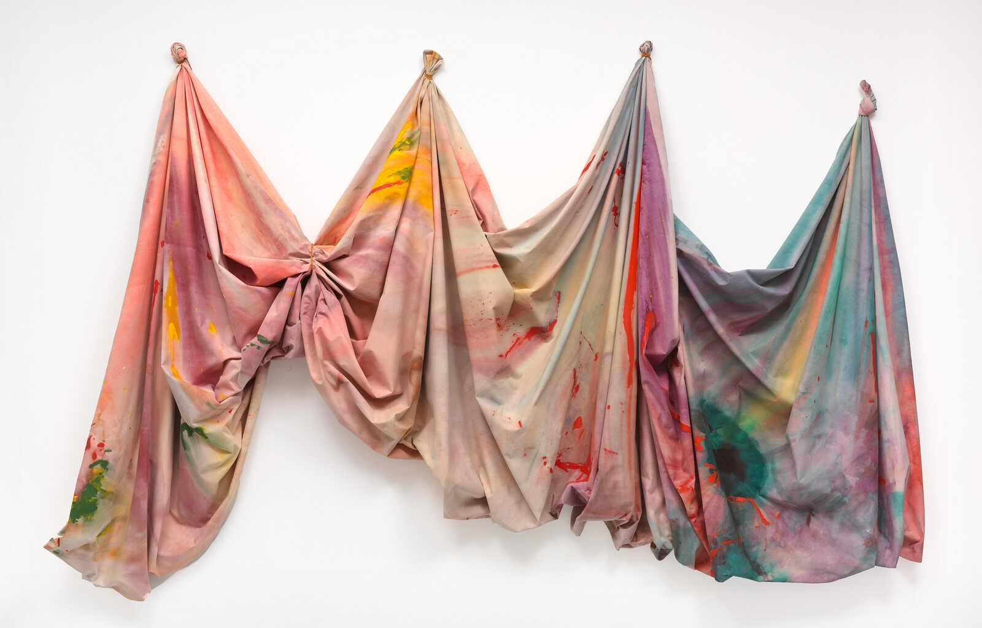
Notes:
Sam Gilliam, Relative, 1968, acrylic on canvas
overall (suspended [installed] canvas): 304.8 x 411.48 cm (120 x 162 in.), overall (full canvas): 304.8 x 1341.1 cm (120 x 528 in.)
National Gallery of Art Washington, Anonymous Gift 1994.39.1
You are looking at a high-resolution digital reproduction of a work of art by Sam Gilliam, titled Relative​, made in 1968. Who is Sam Gilliam? Born in Tupelo, Mississippi, in 1933, Sam Gilliam was raised in Louisville, Kentucky, and studied art at the University of Louisville. After a stint in the Army, he settled in Washington, DC, in 1962, where he found a thriving artistic community in the predominantly African American neighborhood of Shaw, where he still lives today. In DC, Gilliam was introduced to new ideas in abstract art that inspired him to move away from realistic imagery to adopt color as the main subject of his paintings. He soon became associated with the Washington Color School, a group of artists making abstract paintings of expansive color. He began to explore new ways of painting by pouring thinned paint directly onto unprimed canvas. Gilliam’s experimentation led to a major breakthrough when he decided to eliminate the stretcher bars from the canvas, and instead, drape massive billowing fabric on the wall. Partly inspired by the laundry on clotheslines he could see from his apartment window, this new artform—that bridged painting with sculpture—made Gilliam famous internationally. Gilliam loves jazz music, and often listens to it in his studio. He wants to create a similar kind of mood with paint and canvas. He says his work evokes, “the drama of music and the drama of colors coming together. ”After more than sixty years making art, Gilliam continues to explore new possibilities for abstraction, noting, “Even as an artist I discover new things every day, every time I go to a museum, and that’s what the works are there for.”
How did Sam Gilliam make this? Relative​ is an example​ ​of Sam Gilliam’s innovative, large-scale, color-stained drape paintings. The work hangs on the gallery’s wall, 13 ½ feet wide and 10 feet tall. Gilliam invented a new artform with his “drape” paintings. Rather than stretching canvas over a support, or stretcher, to make a flat rectangular surface, he put paint directly onto unstretched, untreated canvas. Gilliam started a work by pouring and blotting watery acrylic paints on large sheets of fabric. Then, as the paints soaked into the surface, he folded them up like accordions, adding additional washes of color. He left the sopping bundles to dry, letting the colors bleed into the fabric. Gilliam liked that chance became part of the process. When he peeled open the canvases... surprise!: dazzling abstractions of swirling, layered color. Gilliam would next bunch up the canvas in areas and “sculpt” it into a three-dimensional fluid shape, suspending it with hooks and ropes and leaving it to hang free. The title of this work, Relative​, refers to the fact that the work of art changes each time it is installed on a different wall or architectural setting—the relationships between the gathered fabric can be adjusted, the folds shift, shadows change, the whole is collectively reshaped. Gilliam believes, “Making, building, thinking —it’s just important. It’s what the world is about.”

